Slide 1

Open Source Air Quality Monitor Update
Adam Dezay, Manny Garcia, Brandon Hippe, and Mercedes Newton

Slide 2

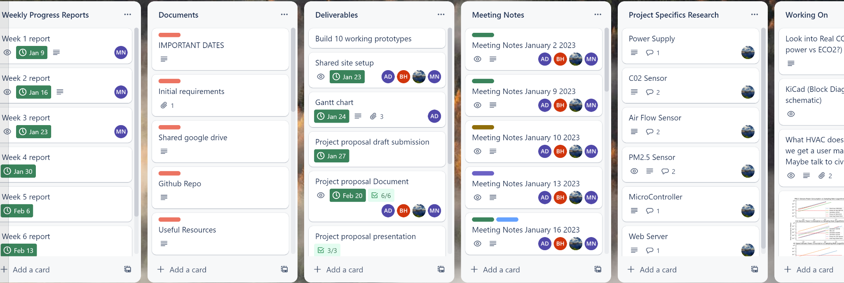
Executive Summary
Project Overview
What stage are we at?
We are beginning our software meshing and optimizing stages (with current emphasis on debugging)! Breadboard Prototype scheduled for April 19th
What have we completed?
We have set up all documentation and shared spaces, held frequent meetings where we collaborated and reported progress, and all have some working code for our specific focuses.
How is the team working?
We enjoy working on this team and have discussed what we would like to emphasize in the upcoming term. We will be paying close attention to documentation however we ultimately would like to spend the next two months with most of our emphasis on the technical aspects of the project.
‹#›

Slide 3
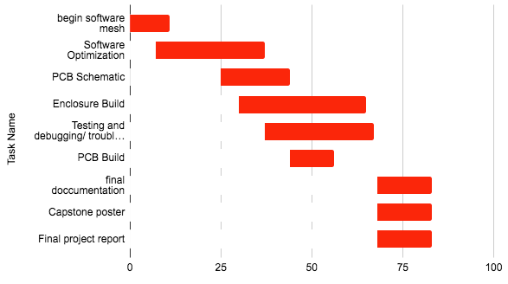
Section Title / Topic
Timeline
Spring Term Project Timeline
Task Name | Start date | End date
Begin software mesh | 3/25/2023 | 4/5/2023
Software Optimization | 4/1/2023 | 5/1/2023
PCB Schematic | 4/19/2023 | 5/8/2023
Enclosure Build | 4/24/2023 | 5/29/2023
Testing and debugging/ troubleshooting code | 5/1/2023 | 5/31/2023
PCB Build | 5/8/2023 | 5/20/2023
final documentation | 6/1/2023 | 6/16/2023
Capstone poster | 6/1/2023 | 6/16/2023
Final project report | 6/1/2023 | 6/16/2023
‹#›

Slide 4
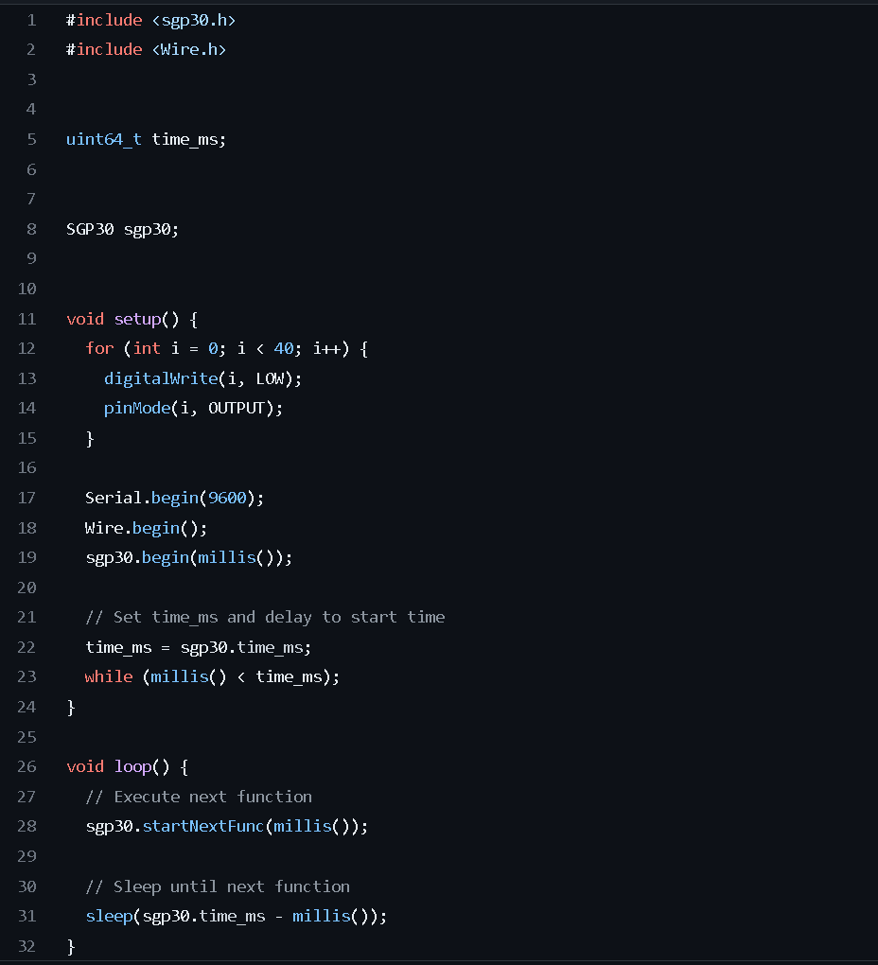
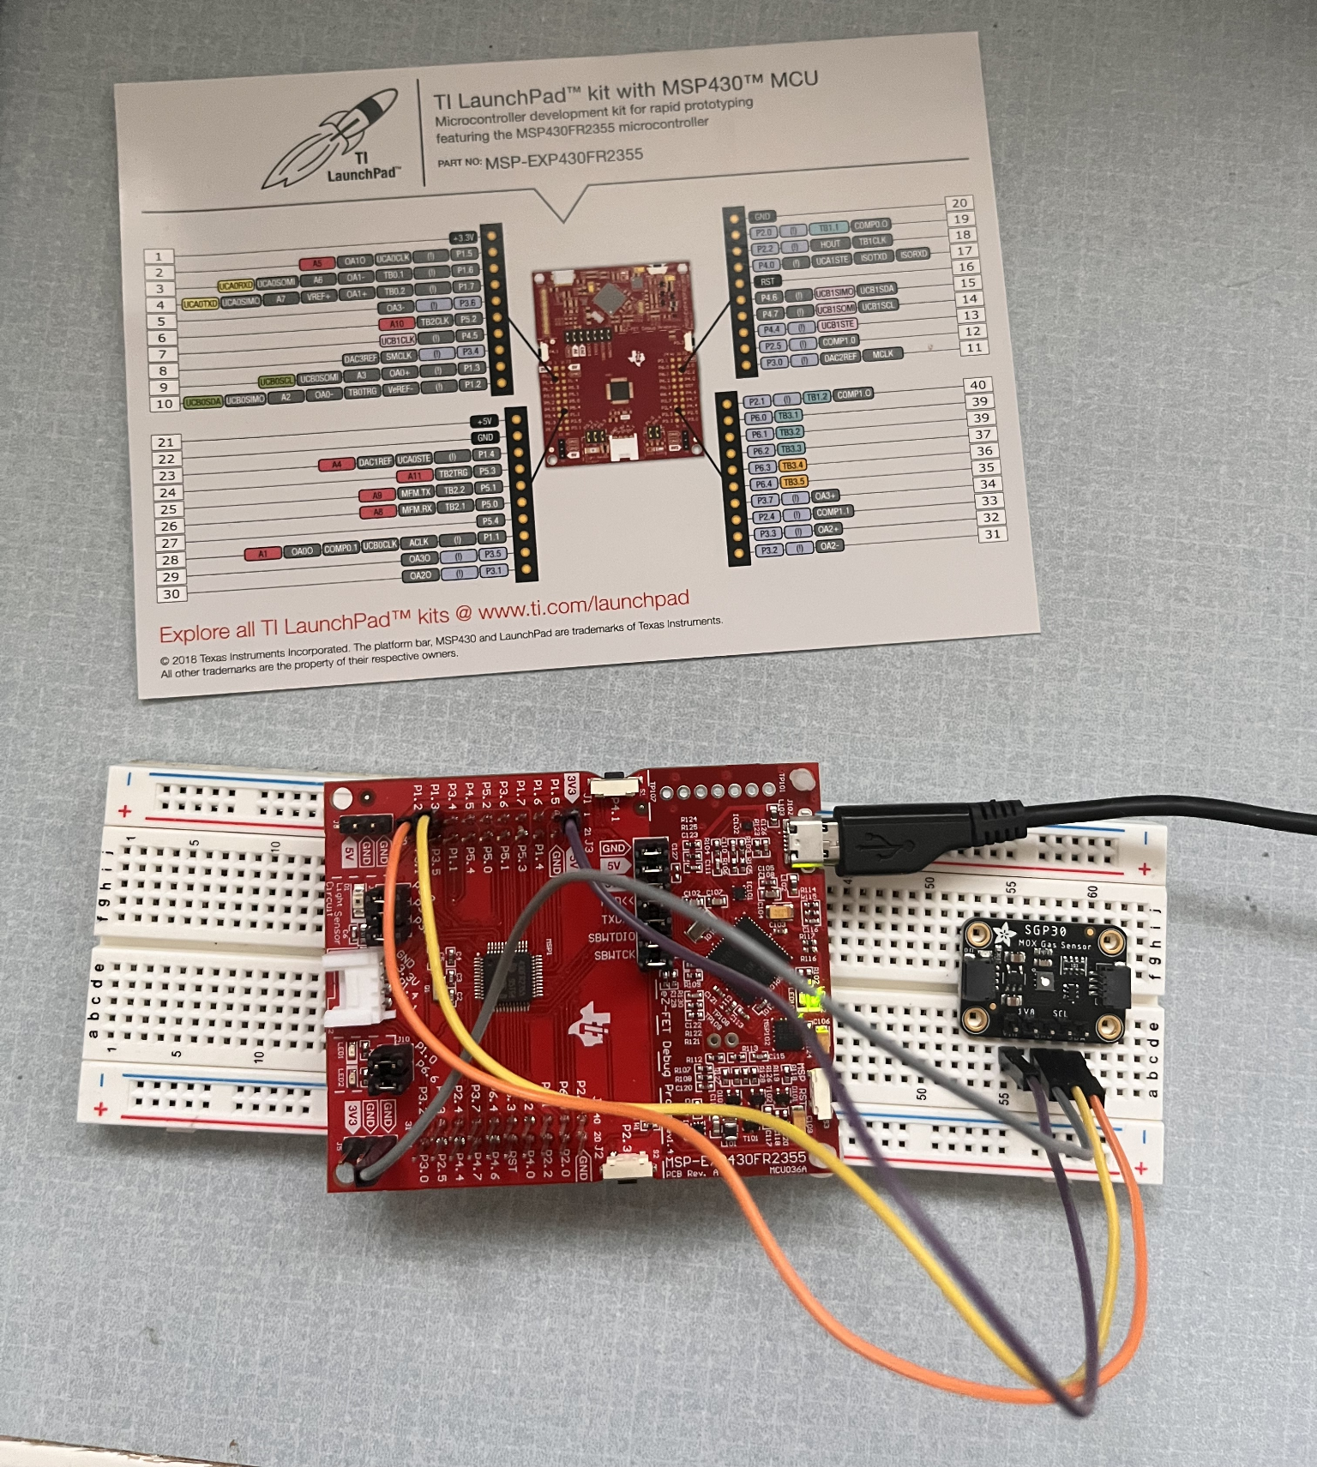
Section Title / Topic
CO2 Sensor (Adam)
Progress
Code compiles
modified arduino code
Energia is functional
Libraries made (Brandon)
Next steps:
Soldering the connections
Github progress
‹#›

Slide 5
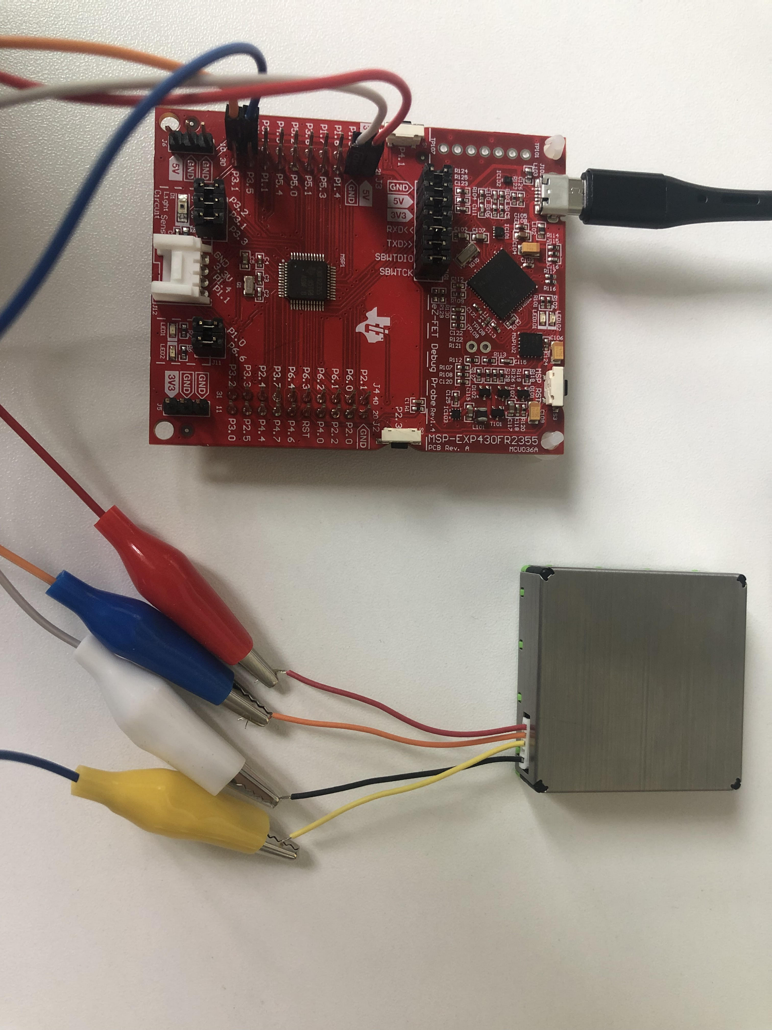
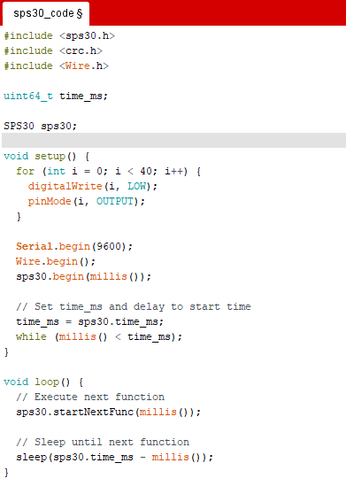
Section Title / Topic
PM2.5 Sensor (Mercedes)
Progress
MSP430 connected to energia
Code compiles (½ computers)
Libraries made (Brandon)
Hardware
Next steps
Produce data
Get second computer to compile
Connect to hardware
‹#›

Slide 6
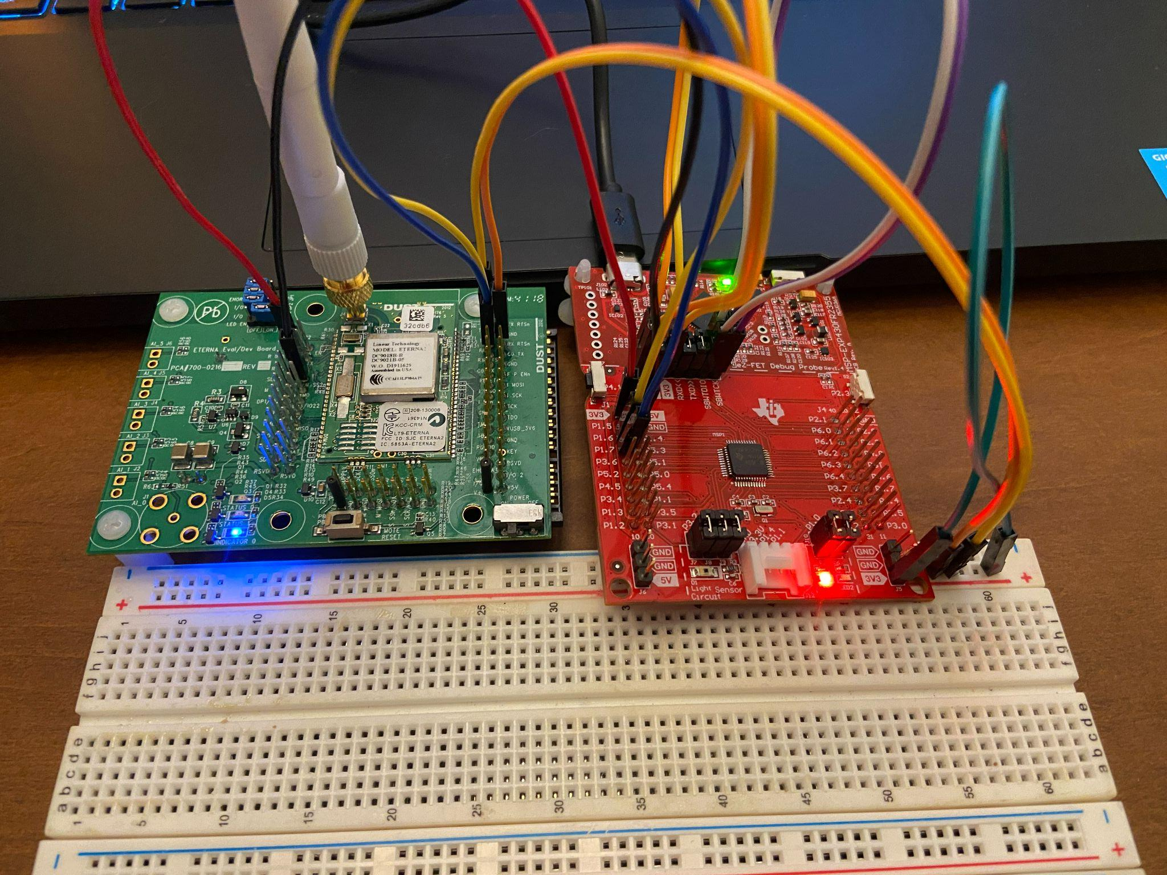
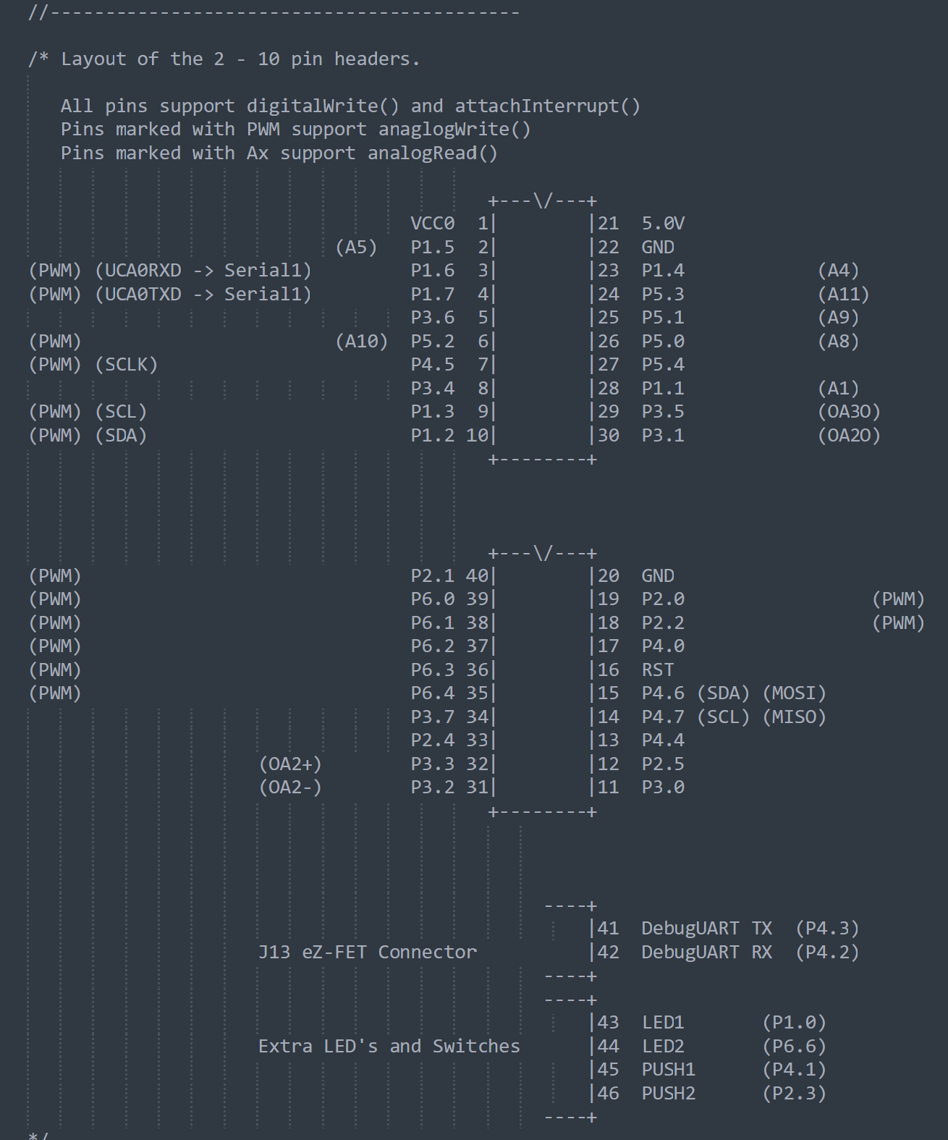
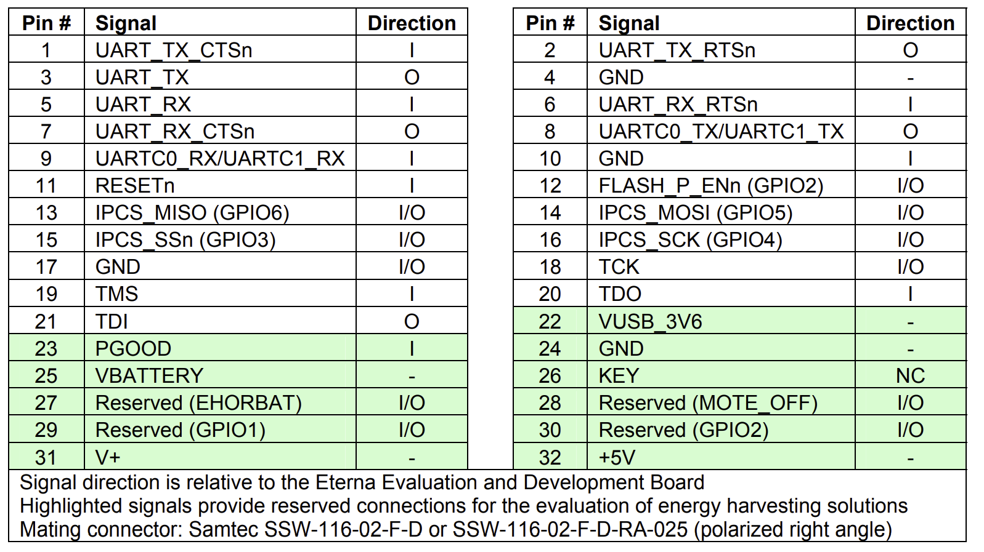
Section Title / Topic
Smartmesh (Manuel)
‹#›

Slide 7
Section Title / Topic
Smartmesh (Manuel)
Positives: - Currently Code and circuit are set up to operate correctly per the data sheets and dissecting last years code and project.
Successfully configured host smarmesh node with my PC
Negative: - Have not been able to verify proper UART transmissions from MSP430fr2355.
So far Smartmesh node is not connecting to host node
Do not yet know how to verify if smartmesh node is receiving and handling transmitted packets correctly
‹#›

Slide 8
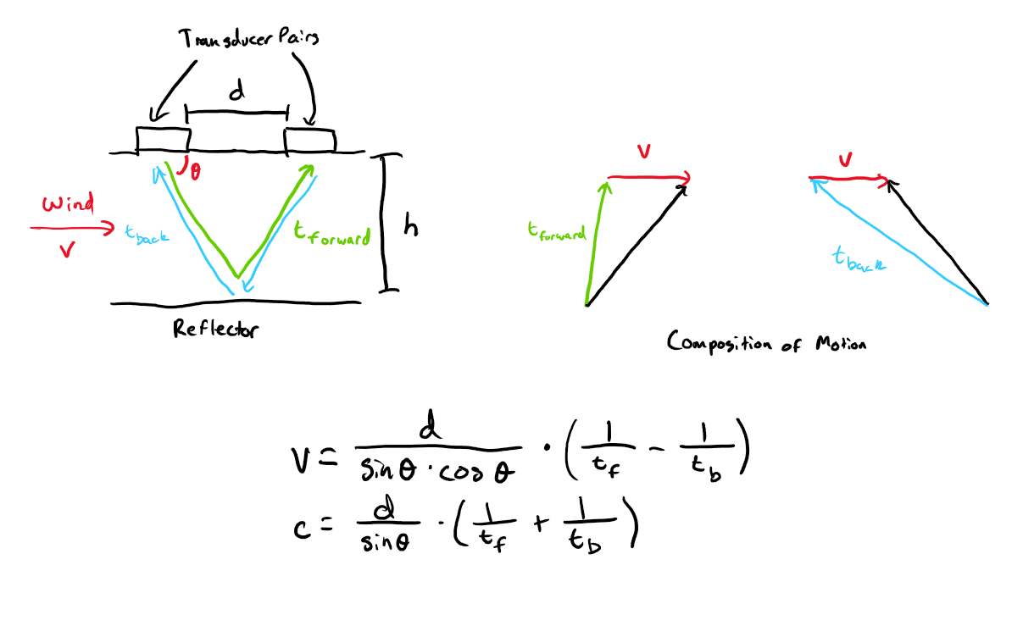
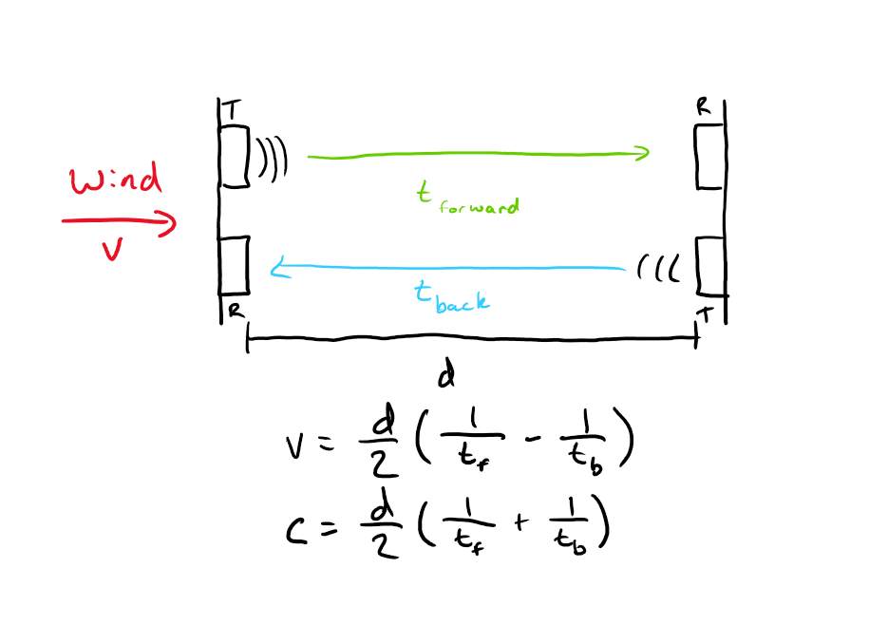
Section Title / Topic
Anemometer (Brandon)
Ultrasonic Anemometer Guides: https://www.dl1glh.de/ultrasonic-anemometer.html and https://github.com/majianjia/QingStation/blob/main/doc/anemometer.md
‹#›

Slide 9
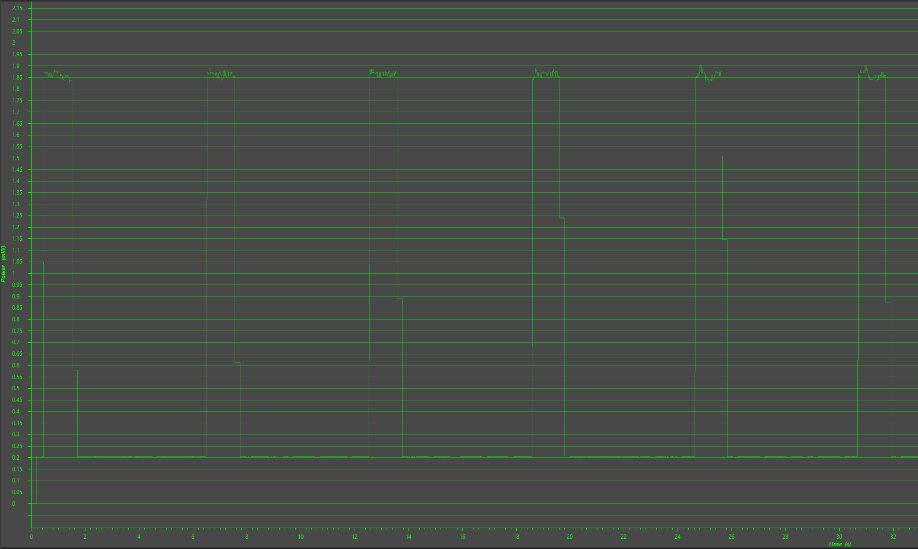
Section Title / Topic
Other Progress
‹#›

